Slide 1
Music Genre Classification
Name | ID
M. J. Darad | 162 0520 042
CSE465.2

Slide 2
Background
Extract meaningful information from songs
Application
Copyright monitoring
Identify song mood/emotions
Music recommendation system
Playlist generation
Optimize song search
Current approaches rely on user input
Unscalable, tedious, highly subjective
More than 75k albums released every year in the US
So, automatic techniques for genre classification are required

Slide 3
Literature Review
Tzanetakis and Cook (2002) addressed this problem with Supervised Machine Learning approaches
Gaussian Mixture Model classifiers
k-nearest neighbour (KNNs) classifiers
Scaringella and Zoia (2005); Soltau et al. (1998) uses Hidden Markov Models (HMMs)
Mandel and Ellis (2005) addressed this problem with Support Vector Machines (SVMs)

Slide 4
Training Set
Song Dataset
Feature Extraction
Testing Set
Accuracy
Classifiers
Neural Net

Slide 5
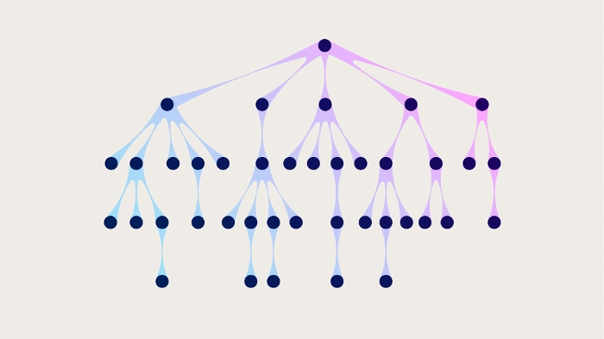
Training Set
Song Dataset
Feature Extraction
Testing Set
Accuracy
Classifiers
Decision Tree

Slide 6
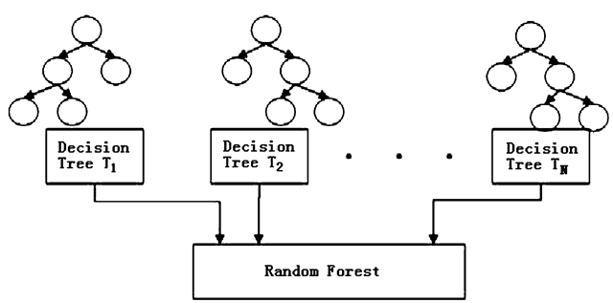
Training Set
Song Dataset
Feature Extraction
Testing Set
Accuracy
Classifiers
Random Forest

Slide 7
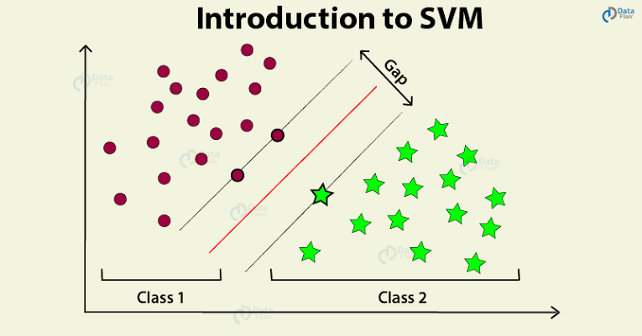
Training Set
Song Dataset
Feature Extraction
Testing Set
Accuracy
Classifiers
Support Vector Machine

Slide 8
Dataset
GTZAN Dataset
1000 audio files
In .au format
16 bit
22050 Hz
30 sec each
Category
Blues
Classical
Country
Disco
Hip-hop
Jazz
Metal
Pop
Reggae
Rock

Slide 9
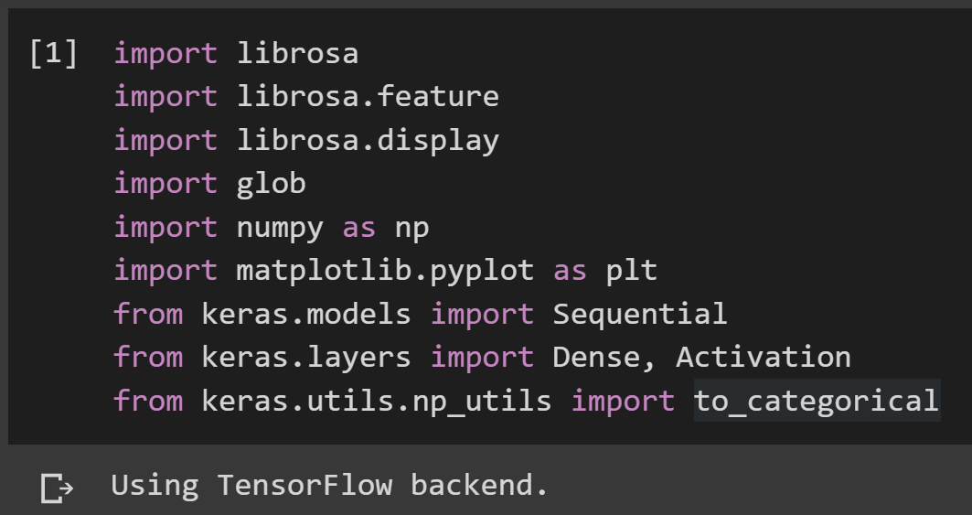
Librairies

Slide 10
Feature Extraction
Mel Cepstrum Frequency Coefficients (MFCC)
MFCC values mimic human hearing,
Widely used feature for speech/sound recognition applications as well as music classification
Takes into consideration human perception of frequencies
Some frequencies are more ‘important’ to human ear than others
MFCC values will be fed directly into the neural network

Slide 11
Neural Network

Slide 12
Vanilla Neural Network
Used a sequential neural network
The first layer is a dense layer of 100 neurons
25,000 values are going to connect to the 100 in the first layer
The first layer will do the weighted sum of its inputs, its weights, and bias term
then run the ReLU activation function
relu states that anything less than 0 will turn out to be a 0
anything higher than 0 will just be the value itself
These 100 will then connect to 10 more and that will be the output layer
It is10 because we have done one-hot encoding and have 10 binary numbers in that encoding
The activation function used is softmax
take the output of the 10 and normalize them so that they add up to 1.
That way, they end up being probabilities
Now consider the highest scoring or the highest probability out of the 10 as the prediction

Slide 13
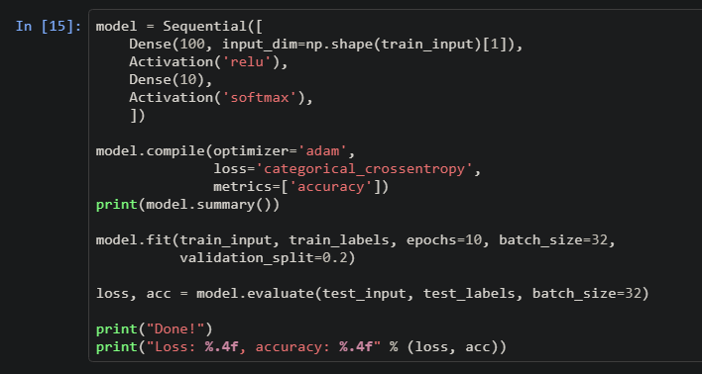
Vanilla Neural Network

Slide 14
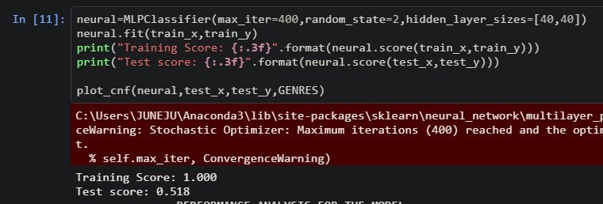
Vanilla Neural Network
With hidden layer

Slide 15
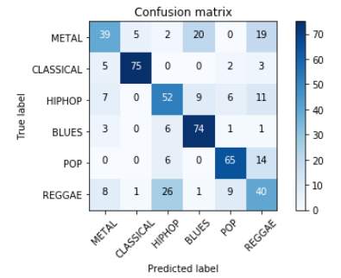
Vanilla Neural Network
Confusion matrix

Slide 16
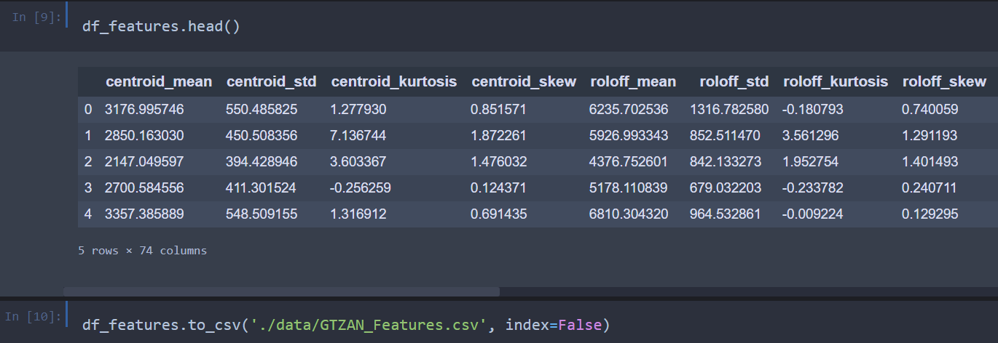
Decision Tree
Data preprocessing

Slide 17
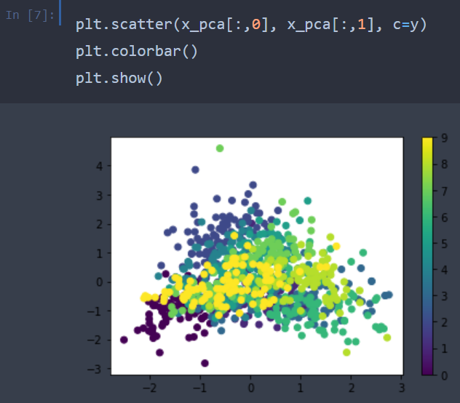
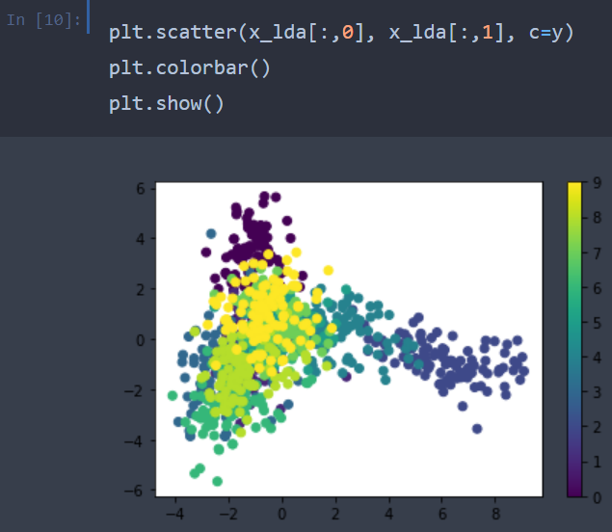
Decision Tree
Data Visualization

Slide 18
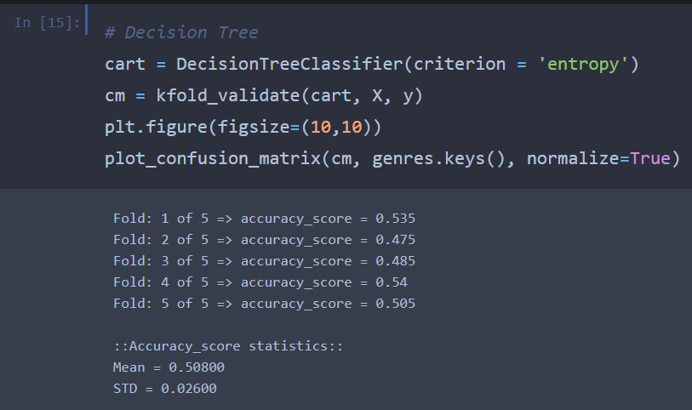
Decision Tree
Code

Slide 19
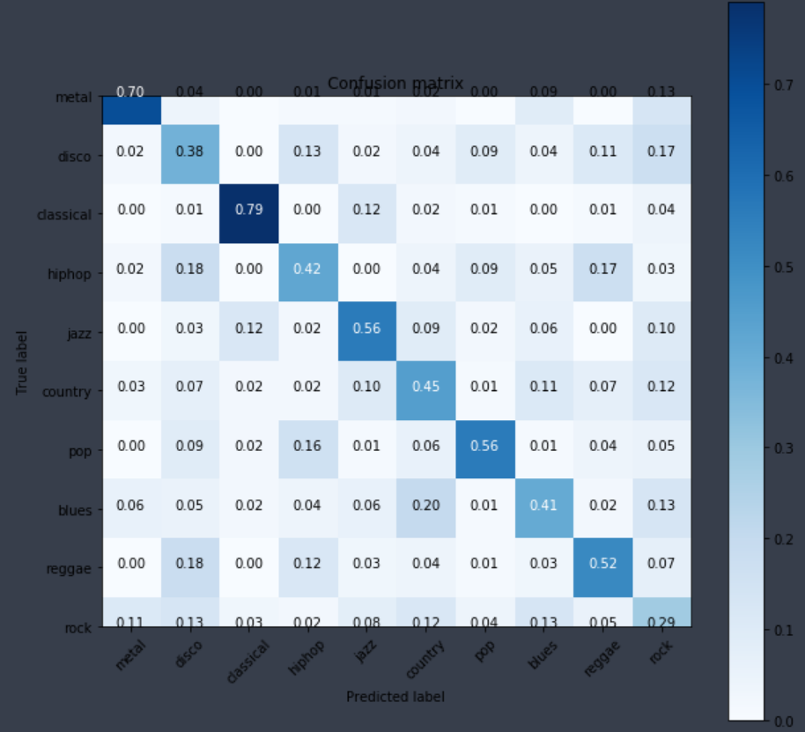
Decision Tree
Confusion matrix

Slide 20
Random Forest
Data preprocessing

Slide 21
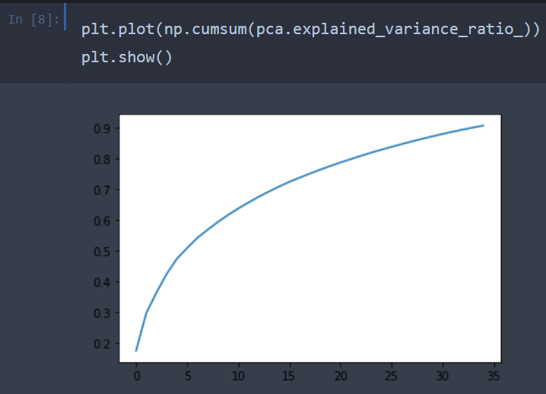
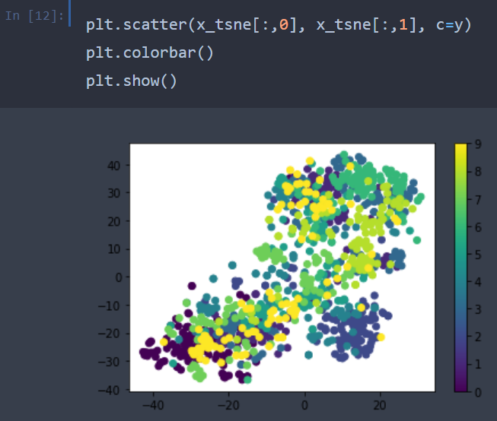
Random Forest
Data Visualization

Slide 22
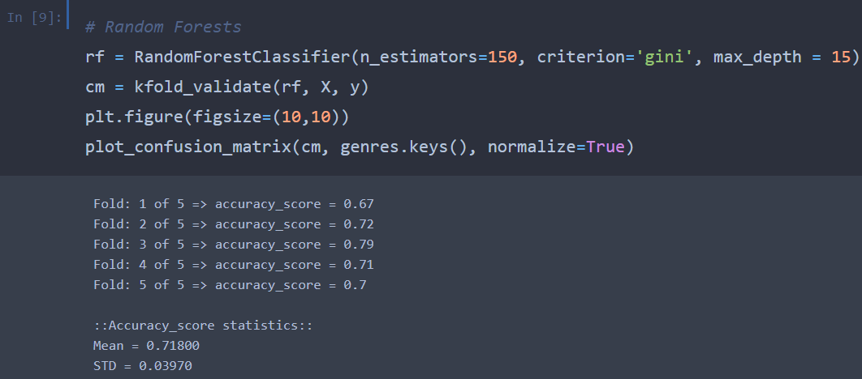
Random Forest
Code

Slide 23
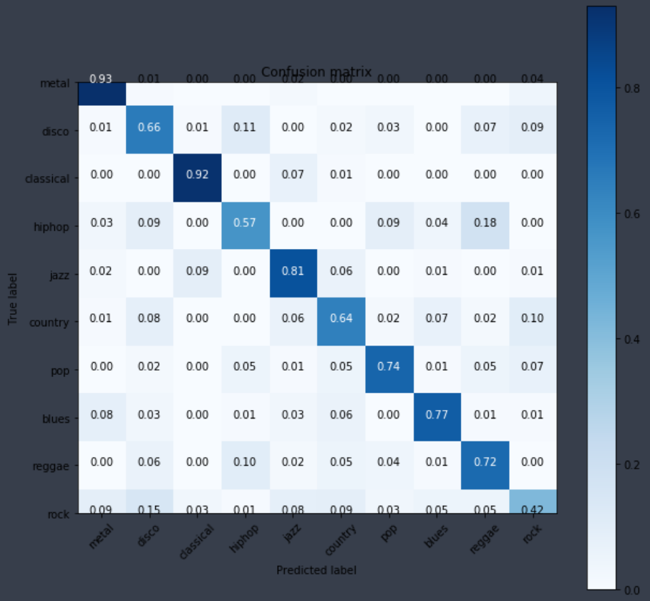
Random Forest
Confusion matrix

Slide 24
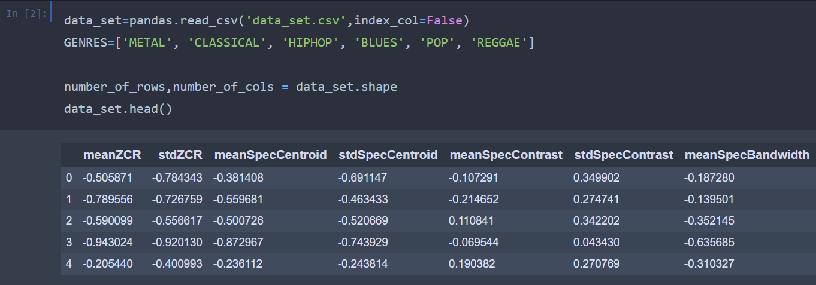
Support Vector Machine
Data preprocessing

Slide 25
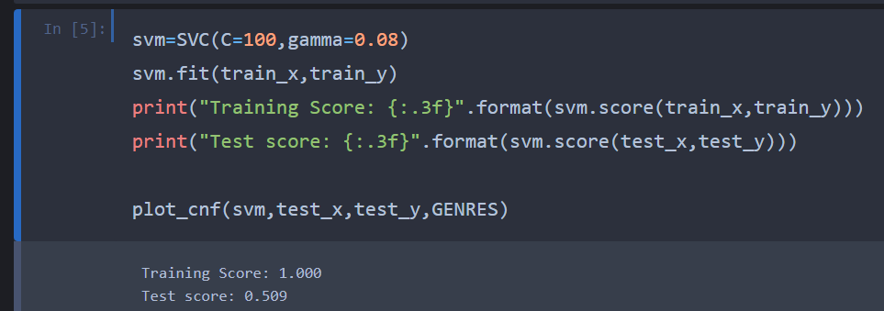
Support Vector Machine
Code

Slide 26
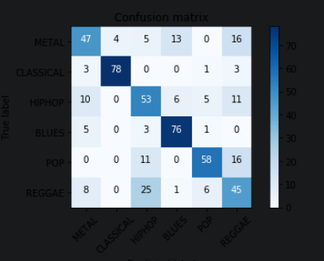
Support Vector Machine
Confusion matrix

Slide 27
Comparison
Model | Accuracy
Vanilla Neural Network | 0.484
Vanilla NN with Hidden Layer | 0.518
Decision Tree | 0.508
Random Forest | 0.718
Support Vector Machine | 0.509

Slide 28
Comparison
With team mates
Model | Accuracy
CNN (2d) | 0.821
CNN (VGG16) | 0.863
Logistic Regression | 0.700
Support Vector Machine | 0.762
Random Forest | 0.718

Slide 29
Work Done
Implemented
Vanilla Neural Network
Decision Tree
Random Forest
Support Vector Machine
Trained the model

Slide 30
Future Work
Tune the model to to improve the performance
To find best number of hidden layers
suitable number of nodes
Use other types of neural networks
Convolutional Neural Network (CNN)
Find the best model

Slide 31
Thank you!!

